Slide 1

推理系统-模型小型化
Transformer 小型化
ZOMI

Slide 2
Talk Overview
推理系统介绍
推理系统与推理引擎区别
推理工作流程
推理系统介绍
推理引擎介绍
模型小型化
基础参数概念
CNN小型化结构
Transform小型化结构
离线优化压缩
低比特量化
二值化网络
模型模型剪枝
模型模型蒸馏
部署和运行优化
图转换优化（算子融合/重排/替换）
并发执行与内存分配
动态batch与bin Packing

Slide 3
深度学习模型发展

Slide 4

Transformer, Attention is all you need
Vaswani, Transformer, 2017

Slide 5
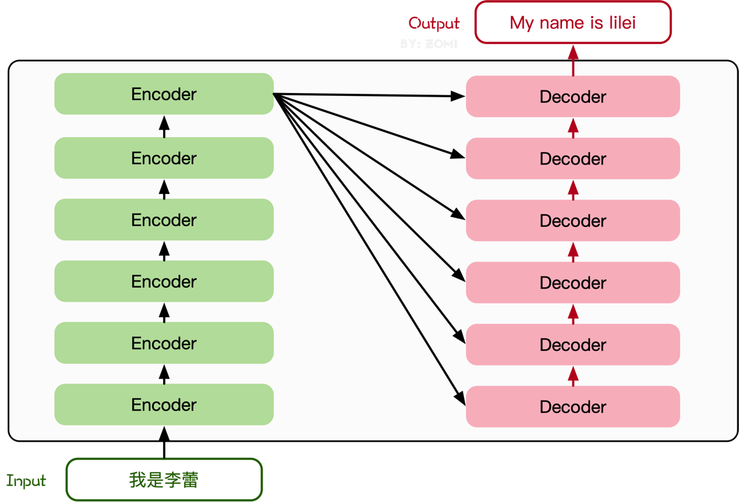
Transformer, Attention is all you need

Slide 6
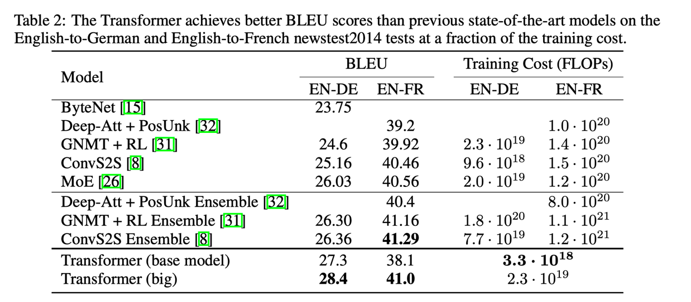
Transformer, Attention is all you need
Transformer solves Seq2Seq problem, replaces LSTM/RNN with a full attention structure:
One step calculation to solve the long-term dependency problem;
The computational complexity of each layer is better;
Point multiplication results can be directly calculated;
Vaswani, Transformer, 2017

Slide 7
Inference
Q8BERT: Quantized 8Bit BERT – 2019.10
DistilBERT, a distilled version of BERT: smaller, faster, cheaper and lighter – 2019.10
TinyBERT: Distilling BERT for Natural Language Understanding – 2019.09
Training data-efficient image transformers & distillation through attention – 2021.3
MiniViT: Compressing Vision Transformers with Weight Multiplexing – 2022.04
TinyViT: Fast Pretraining Distillation for Small Vision Transformers – 2022.06
DynamicViT: Efficient Vision Transformers with Dynamic Token Sparsification - 2022.10
Compressing Visual-linguistic Model via Knowledge Distillation – 2021.03
MiniVLM: A Smaller and Faster Vision-Language Model – 2021.09

Slide 8
轻量级模型
MobileViT （2021）
Mobile-Former（2021）
EfficientFormer（2022）

Slide 9
轻量化网络总结
如何选择轻量化网络：
不同网络架构，即使 FLOPs 相同，但其 MAC 也可能差异巨大
FLOPs 低不等于 latency 低，结合具硬件架构具体分析
多数时候加速芯片算力的瓶颈在于访存带宽
不同硬件平台部署轻量级模型需要根据具体业务选择对应指标

Slide 10
Inference
Q8BERT: Quantized 8Bit BERT – 2019.10
DistilBERT, a distilled version of BERT: smaller, faster, cheaper and lighter – 2019.10
TinyBERT: Distilling BERT for Natural Language Understanding – 2019.09
Training data-efficient image transformers & distillation through attention – 2021.3
MiniViT: Compressing Vision Transformers with Weight Multiplexing – 2022.04
TinyViT: Fast Pretraining Distillation for Small Vision Transformers – 2022.06
DynamicViT: Efficient Vision Transformers with Dynamic Token Sparsification - 2022.10
Compressing Visual-linguistic Model via Knowledge Distillation – 2021.03
MiniVLM: A Smaller and Faster Vision-Language Model – 2021.09

Slide 11
Notes:
11

